Slide 1
Product Price Prediction
Team Members: Jin Chen, Zhi Li, Juliana Ma, Zhiying Zhu

Slide 2

Who cares?
Business owners
Customers
Data Scientists

Slide 3
Overview of the Project
How do you determine the price for your product?
Name ?
Brand ?
Category ?
Description ?

Slide 4
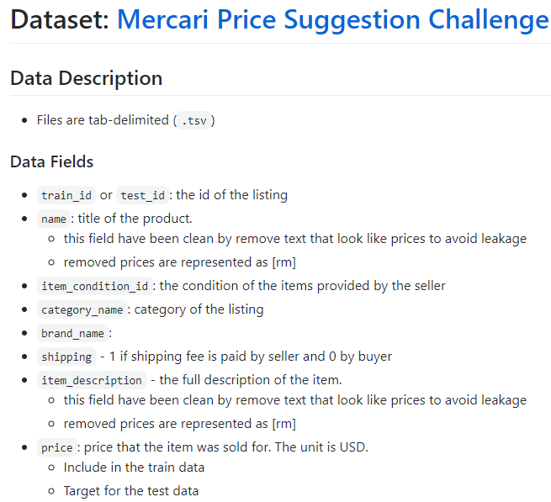
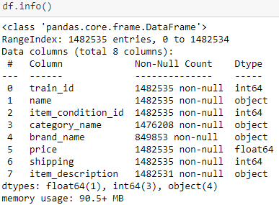
Dataset

Slide 5
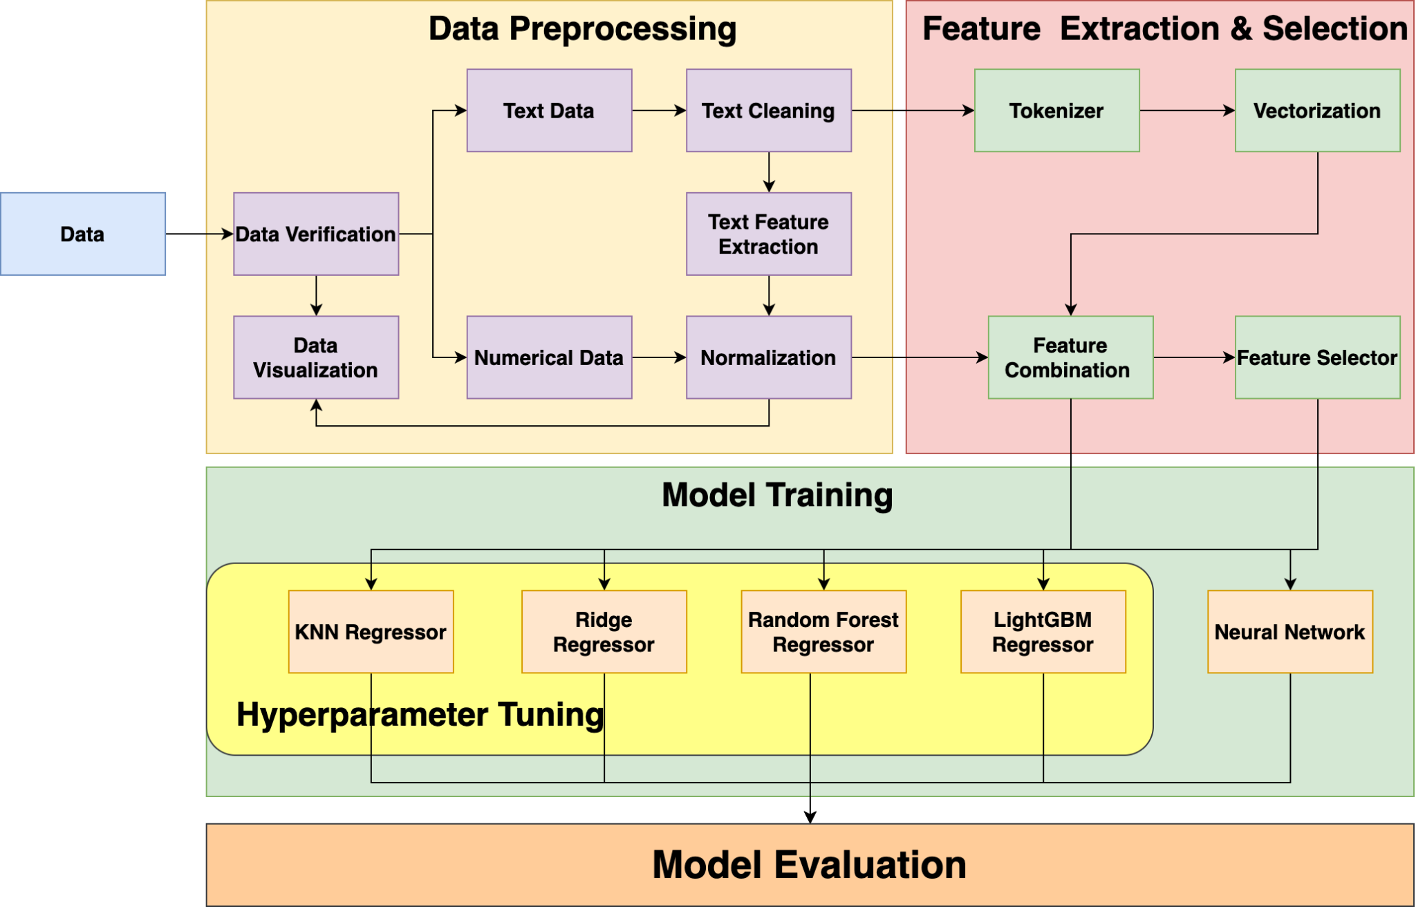

Slide 8
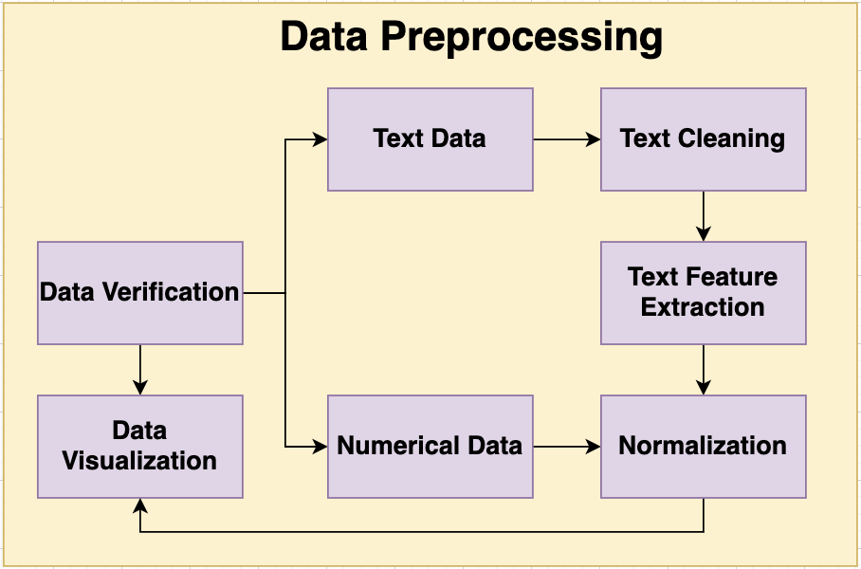
EDA - Data Processing

Slide 9
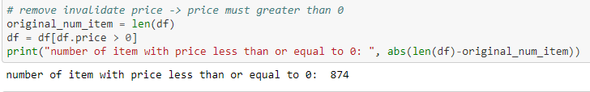
Data Validation
Removed invalid variables ( price <= 0)

Slide 10
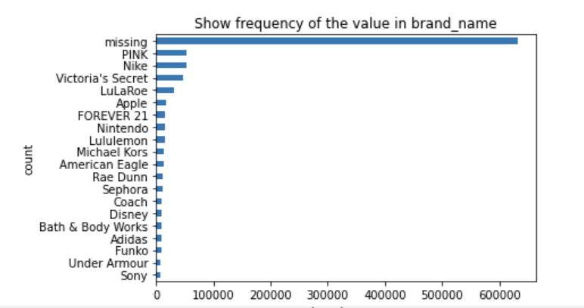
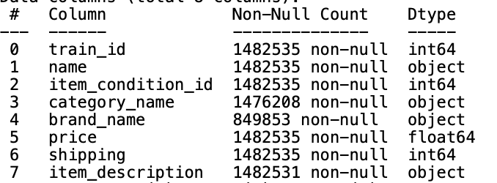
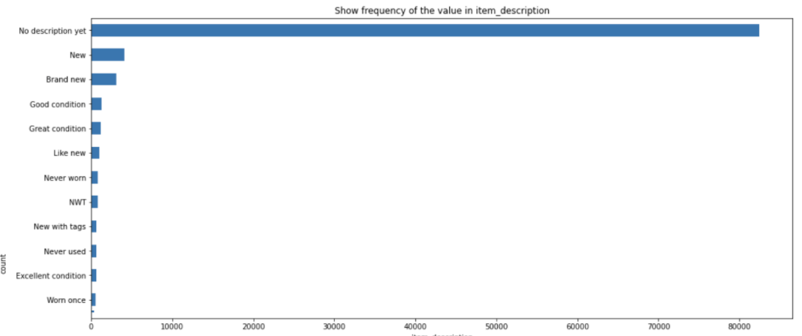
Missing Data

Slide 11
EDA - Data Processing

Slide 12
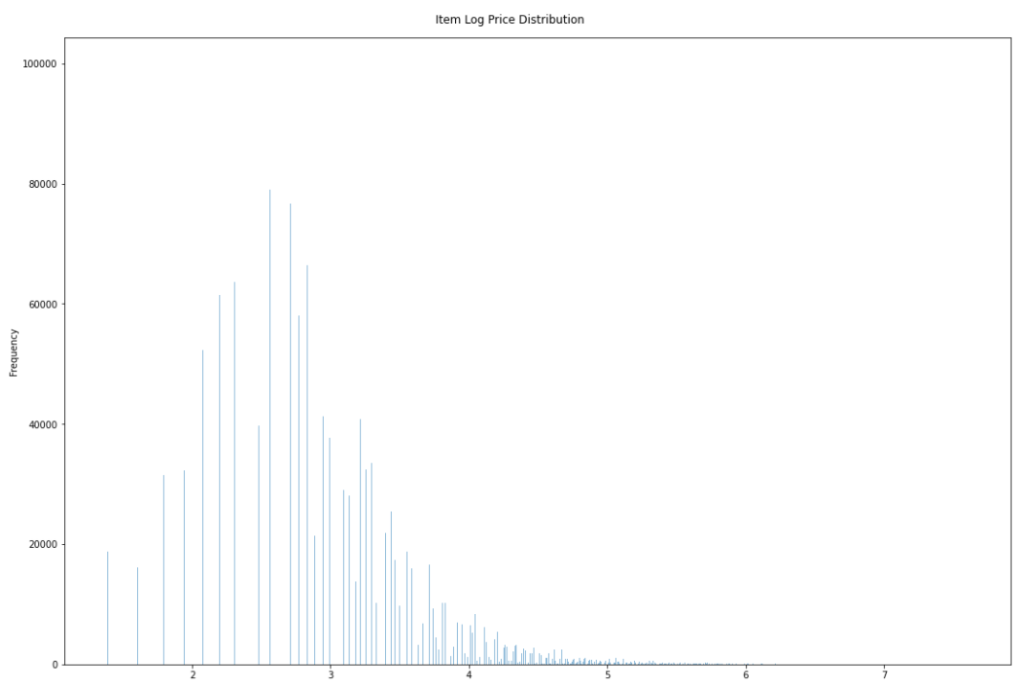
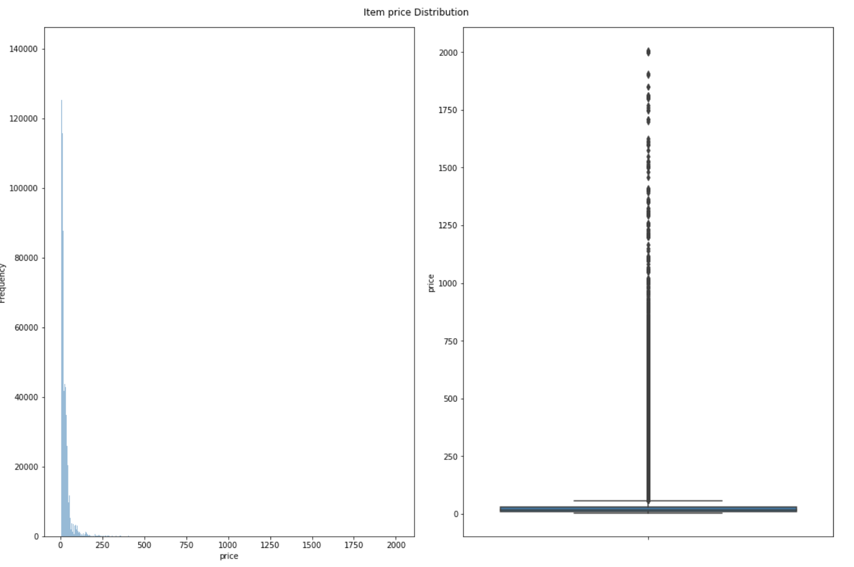
Data Visualization - Numerical Attributes
Price
Log Price

Slide 13
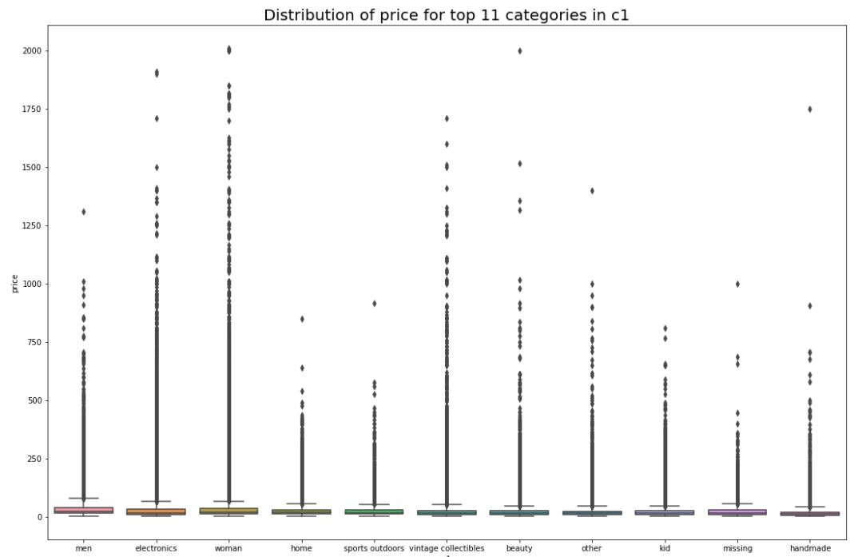
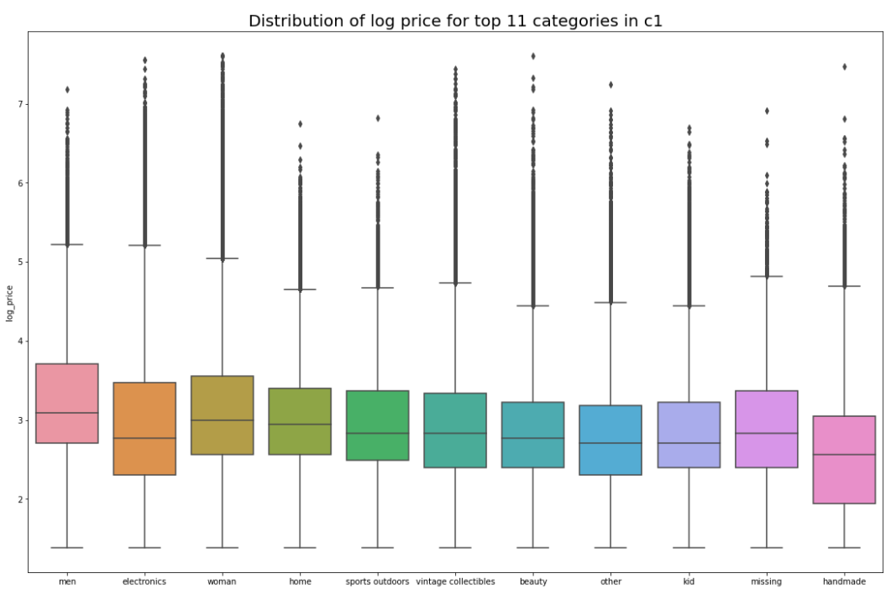
Data Visualization - String Attributes

Slide 15
Data Cleaning - Text
1. Standardize all text to its lower case
2. Use the re package to extract only characters and numbers and remove any special characters and emoji
3. Use the NLTK stopwords package to remove stop words and non-alphabetical words
4. Use the WordNetLemmatizer package to reduce word to its root form
5. Use the string package to replace all punctuation by white space
Notes:
Zhiying 11 - 18

Slide 17
Basic Text Features Cleaning/ Extraction
We do not want to lose any information in string columns which we plan to perform text pre-processing on. It’s possible that uppercase/lowercase letters, emoji and special characters play a role in price prediction.
Hence we specifically built two functions
“Get_word_count” → extract uppercase & lowercase counts, uppercase & lowercase ratio in a corpus, and average word length in a corpus
“Get_special_char_count → extract stop word & punctuation & special characters counts in a corpus
All of these extracted features will feed into the feature selection model as additional distinct features.
Notes:
Zhiying 10 - 18
df = get_word_count(df, columns = ["clean_name", "clean_description", 'c1', 'c2', 'c3','brand_name'], print_col=True)
df = get_special_char_count(df, columns = ["name", "item_description"], print_col=True)

Slide 19
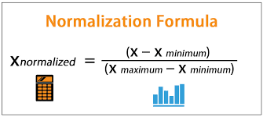
Data Normalization
Min-Max normalization is performed on all numerical (both original and extracted) attributes from the dataset
If max - min = 0, then drop that column
The “train_id”, “item_condition_id”, “price”, and “shipping” columns were skipped from this normalization step
Notes:
# normalize numeric data
df, numeric_column = normalize_numeric_col(df,skip_cols=['train_id','item_condition_id','price','shipping'],

Slide 21
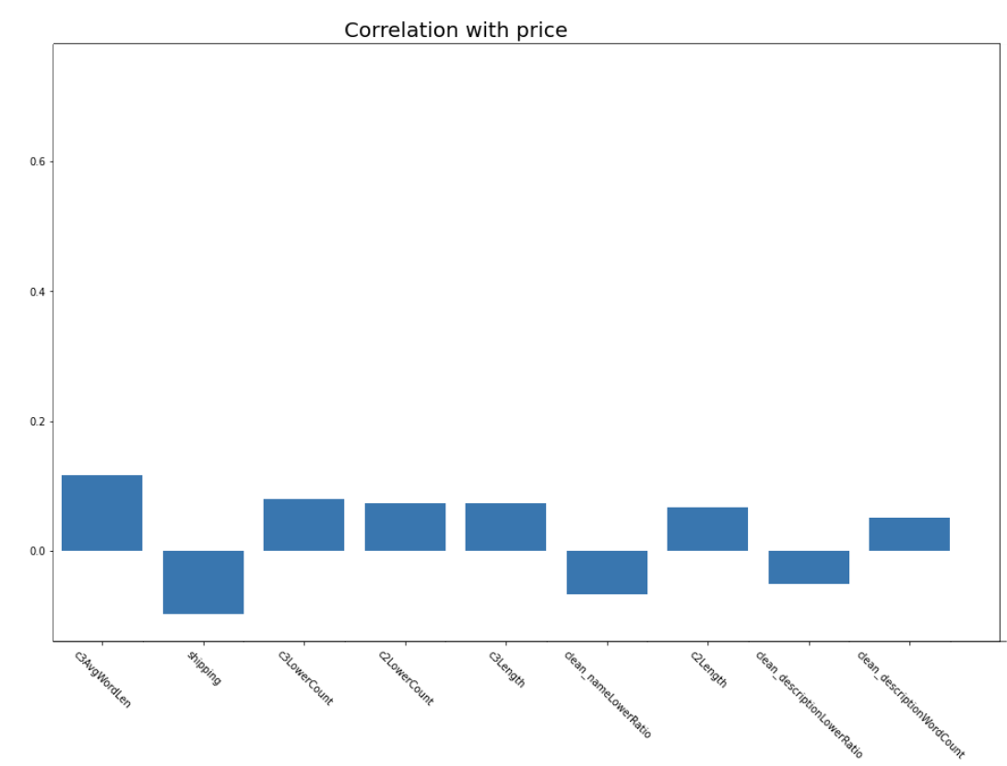
Features Correlation with Price
After performing text feature extraction, we compute the correlation of coefficient between each feature and price.
The top 10 features with the highest correlation with price is plotted in a bar chart.
No direct correlation

Slide 22
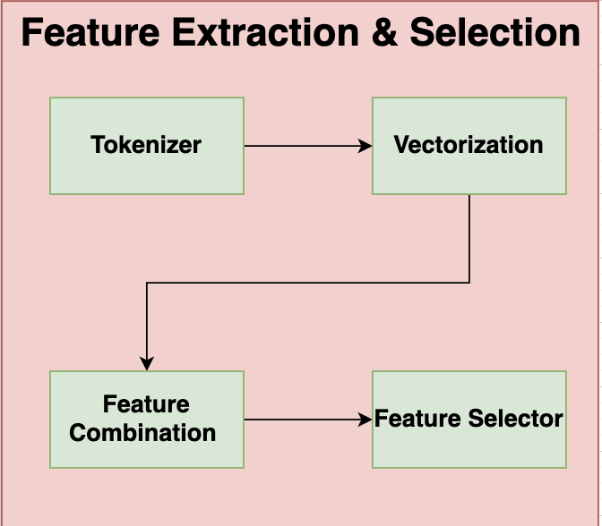
Feature Extraction Process

Slide 23
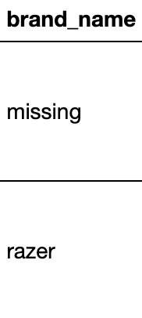
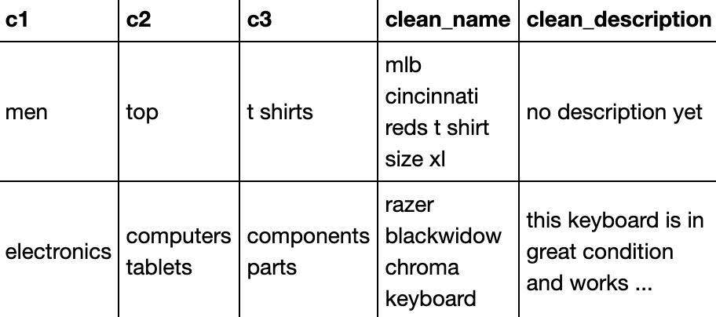
Categorical Feature Extraction
“Brand_name”, “c1”, “c2”, “c3”:
Perform train-test split
On both train and test set, perform One-Hot encoding yield ~6,000 features
On both train and test set, perform Sklearn CountVectorizer yield ~1,200 features (final)
Size of vectorization features of c1 is 12
Size of vectorization features of c2 is 106
Size of vectorization features of c3 is 379
Size of vectorization features of brand_name is 726
Notes:
We used ONE-HOT encoding previously, nearly returned 6 thousands features
But using CountVectorizer, we get ~1 thousand features but still maintain all information

Slide 24
Text Feature Extraction
“Name”, “description”:
Contain with bulks of text
Sklearn TfidfVectorizer to vectorize the text features
Limit the maximum number of feature to 15,000 for “description”
with more than 15,000 features
No maximum feature limit is set for “name”
with less than 15,000 features
Size of vectorization features of clean_name is 3,629
Size of vectorization features of clean_description is 15,000
Notes:
Limit the maximum number of feature to 15,000 for attributes with more than 15,000 features after vectorization
No maximum feature limit is set for attributes with less than 15,000 featuress

Slide 25
Feature Extraction Process

Slide 26
Total Features
Size of vectorization features of c1 is 12
Size of vectorization features of c2 is 106
Size of vectorization features of c3 is 379
Size of vectorization features of brand_name is 726
Size of vectorization features of clean_name is 3629
Size of vectorization features of clean_description is 15000
Size of other features is 38
Total feature size is 18,980 for a item

Slide 27
Feature Selection

Slide 28
Feature Selection
SkLearn Library - SelectKBest
Select features according to the k highest scores
Using F-value between target and features for scoring function
Recursive Feature Elimination
Feature ranking with recursive feature elimination.
Each iteration remove 5% of the features with lowest score
Using Ridge as the external estimator that assigns weights to features

Slide 29
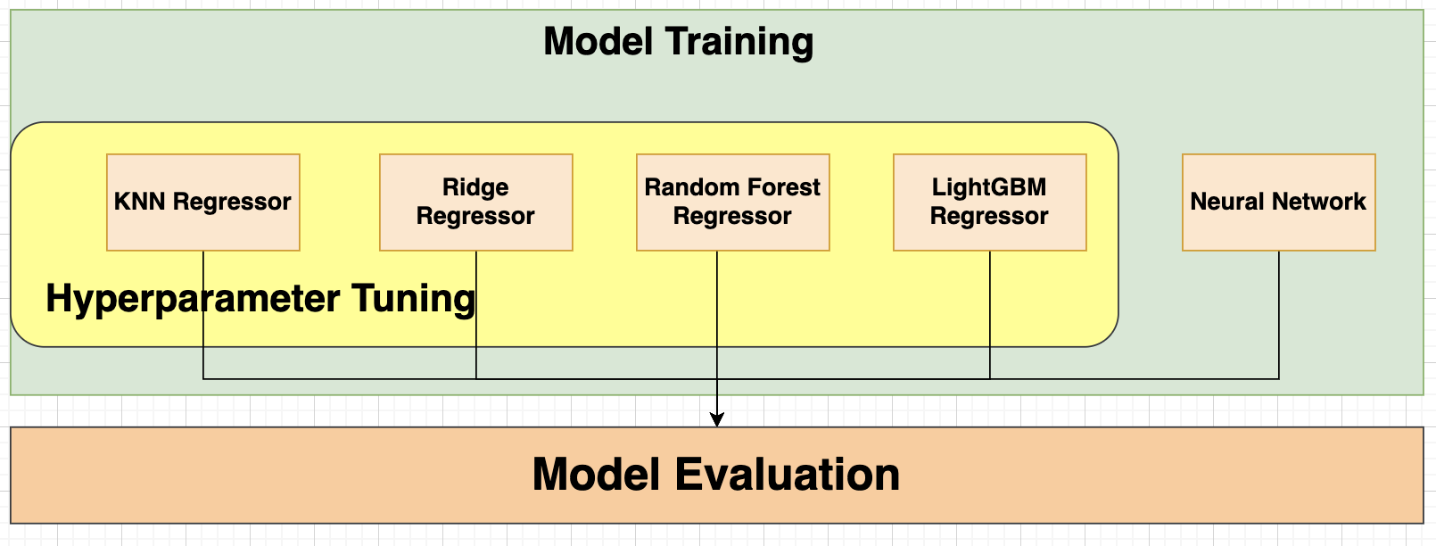
Model and Evaluation

Slide 30
Data Sampling
Different sample generated based on the purpose
for brand name, item category (3 different level), price (separate into bins)
Evenly distribute among between different class, and have replacement of the samples if needed
Continuous Variable: Price
Separate into bins (not uniform size bins, as price has a skewed distribution)

Slide 31
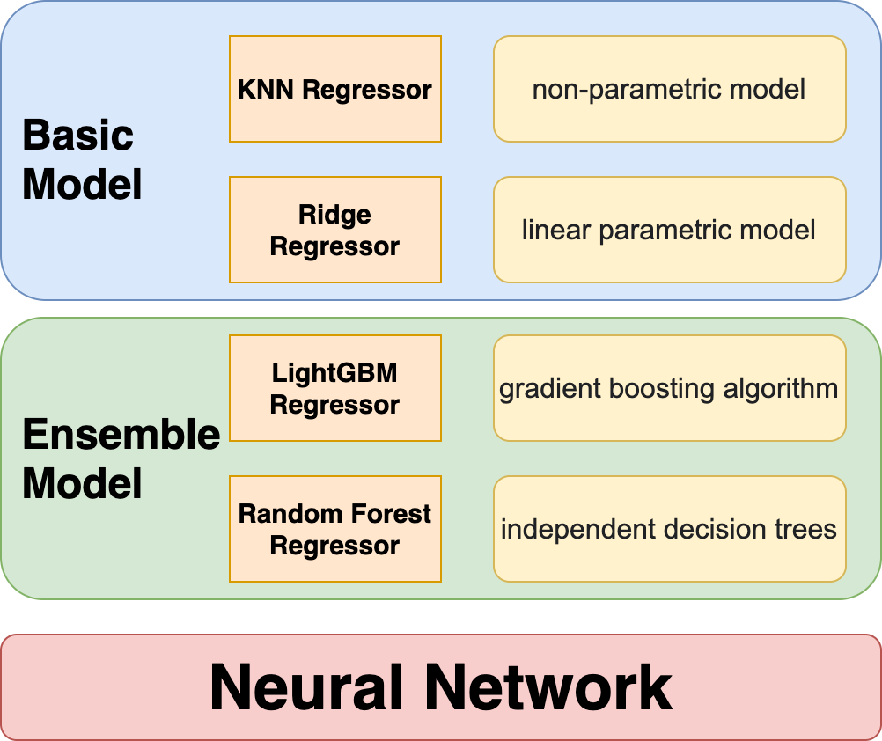
Experiment Models
Notes:
GB -> previous model set the target outcomes for this next model in order to minimize the error

Slide 32
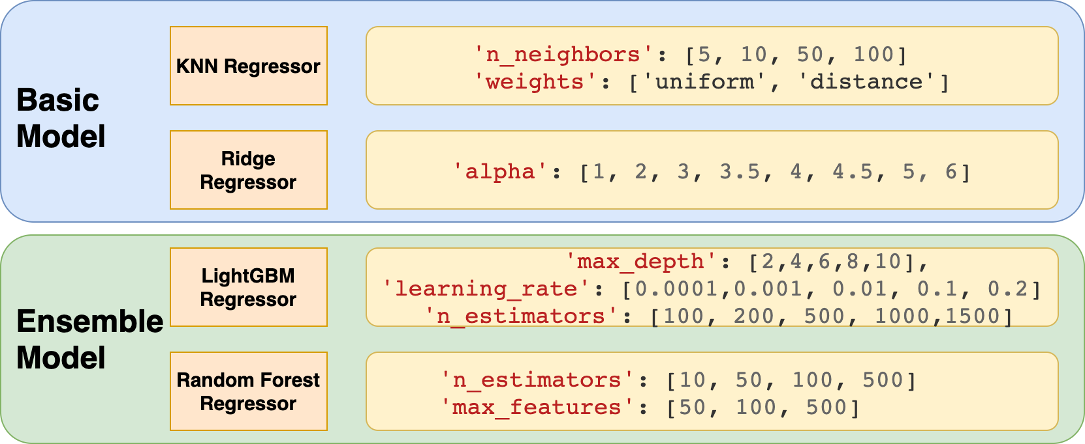
Hyperparameter Tuning
with small sample set

Slide 33
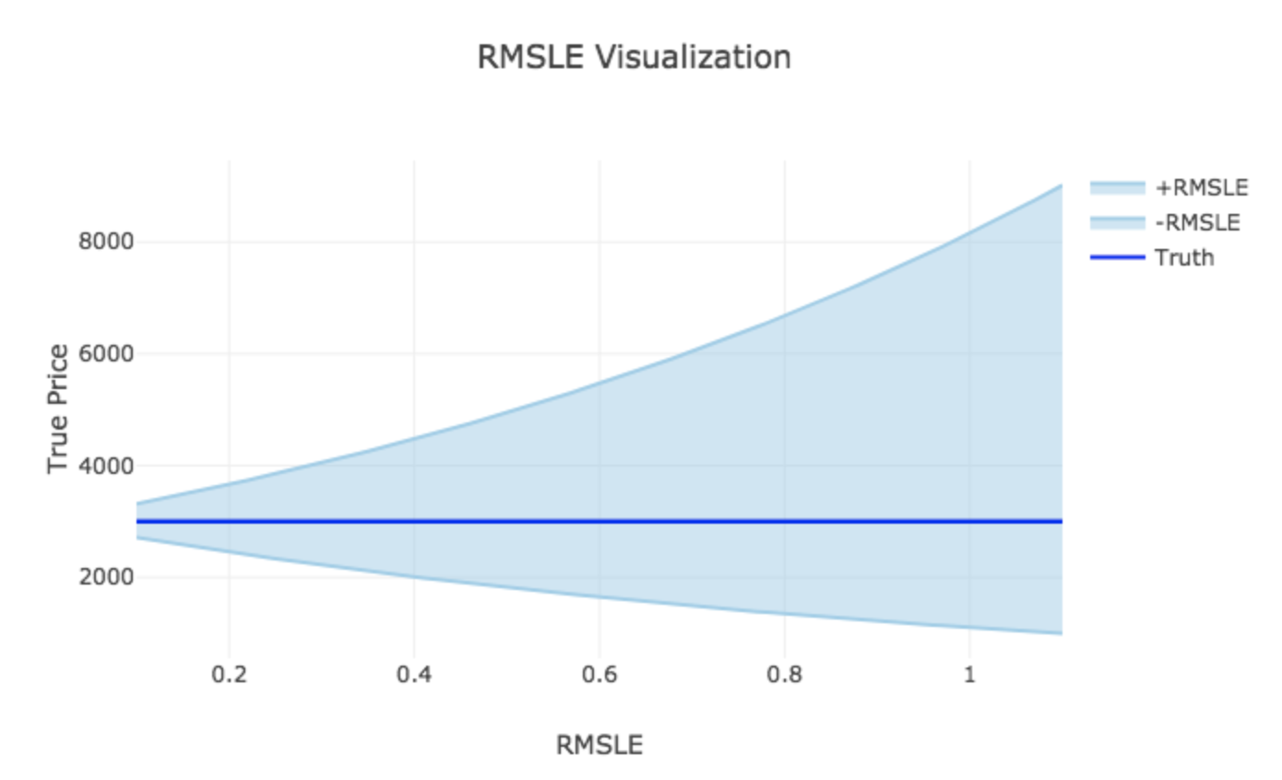
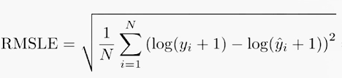
Main Evaluation Metrics - RMSLE
Robust to the effect of the outliers
Notes:
RMSLE doesn’t penalize large errors. It is usually used when you don’t want to influence the results if there are large errors. RMSLE penalize lower errors.

Slide 34
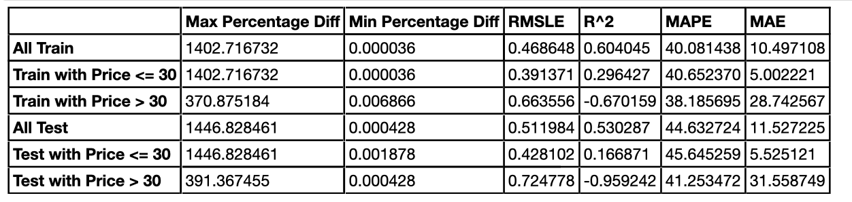
Other Interesting Metrics
Affected by outliers, not used for determine the best model during hyperparameter tuning
Mean Absolute Percentage Error (MAPE)
Mean Absolute Error (MAE) -> how the predict price is off from the original price
R Square (R^2) -> how model fits the dependent variables
Max Percentage Difference between predict price and original price
Notes:
MAPE -> intuitive interpretation in terms of relative error
MAE ->

Slide 35
Experiment

Slide 36
Different models
 |  | Mean_squared_error |  | R2_score
Input data | Number of features | 3000 | 500 PCA | 3000 | 500 PCA
DT | Train | 1.4e-5 | 1.4e-5 | 0.999 | 0.999
 | Test | 12946 | 20796 | 0.661 | 0.452
RF | Train | 920 | 990 | 0.977 | 0.975
 | Test | 6343 | 8995 | 0.833 | 0.761
LM/Ridge/Lasso | Train | - | 995 | - | 0.975
 | Test | - | 22252 | - | 0.409

Slide 37
Tuning max_depth for RandomForest
max_depth=5
Train score: MSE: 21057.029939771488 EVS: 0.4772077882729734 R2: 0.47720766609829124
Test score: MSE: 20577.931784453962 EVS: 0.45403565555985825 R2: 0.4540356146509056
max_depth=10
Train score: MSE: 8179.695234473132 EVS: 0.7969521068442579 R2: 0.7969190349034903
Test score: MSE: 14594.527861163047 EVS: 0.6128282665572381 R2: 0.6127845831814942
max_depth=15
Train score: MSE: 2797.4635704760167 EVS: 0.9307569031211611 R2: 0.9305461162757869
Test score: MSE: 11716.699406904356 EVS: 0.689145003730799 R2: 0.6891378270170323
max_depth=17
Train score: MSE: 2025.2971467016655 EVS: 0.9500065582725359 R2: 0.9497170386708333
Test score: MSE: 11247.78553722474 EVS: 0.7015789850997511 R2: 0.7015788378689929
max_depth=20
Train score: MSE: 1454.5643937422979 EVS: 0.9642602693242058 R2: 0.9638868769057223
Test score: MSE: 10929.77471086252 EVS: 0.7100288984049611 R2: 0.7100161573803916
max_depth=None
Train score: MSE: 977.6322390524449 EVS: 0.9762643748608849 R2: 0.9757278855843557
Test score: MSE: 10828.01092624251 EVS: 0.7128459008502149 R2: 0.7127161081190192
Best bias-variance trade off

Slide 38
Tuning parameters for NNs
Baseline (3 layers, dense:100, activation:relu, epochs=100):
Train score: MSE: 8415.242815932415 EVS: 0.791611134779733 R2: 0.7910709893715125
Test Score: MSE: 13037.545496267461 EVS: 0.6541490753629551 R2: 0.6540937355663705
Double dense(dense: 200):
Train score: MSE: 8173.072073676178 EVS: 0.8008081803783588 R2: 0.7970834710894458
Test Score: MSE: 13099.043639588555 EVS: 0.6592594682458096 R2: 0.6524620946235341
Adding one layer:
Train score: MSE: 7688.734956909837 EVS: 0.8091091853936212 R2: 0.8091083260853184
Test Score: MSE: 12589.29257507735 EVS: 0.6665697752832248 R2: 0.6659865794712854
Using sigmoid activation:
Train score: MSE: 7784.718255411463 EVS: 0.8067297964037081 R2: 0.8067253056506808
Test Score: MSE: 12841.135278891377 EVS: 0.6598098408051718 R2: 0.6593048026808523

Slide 39
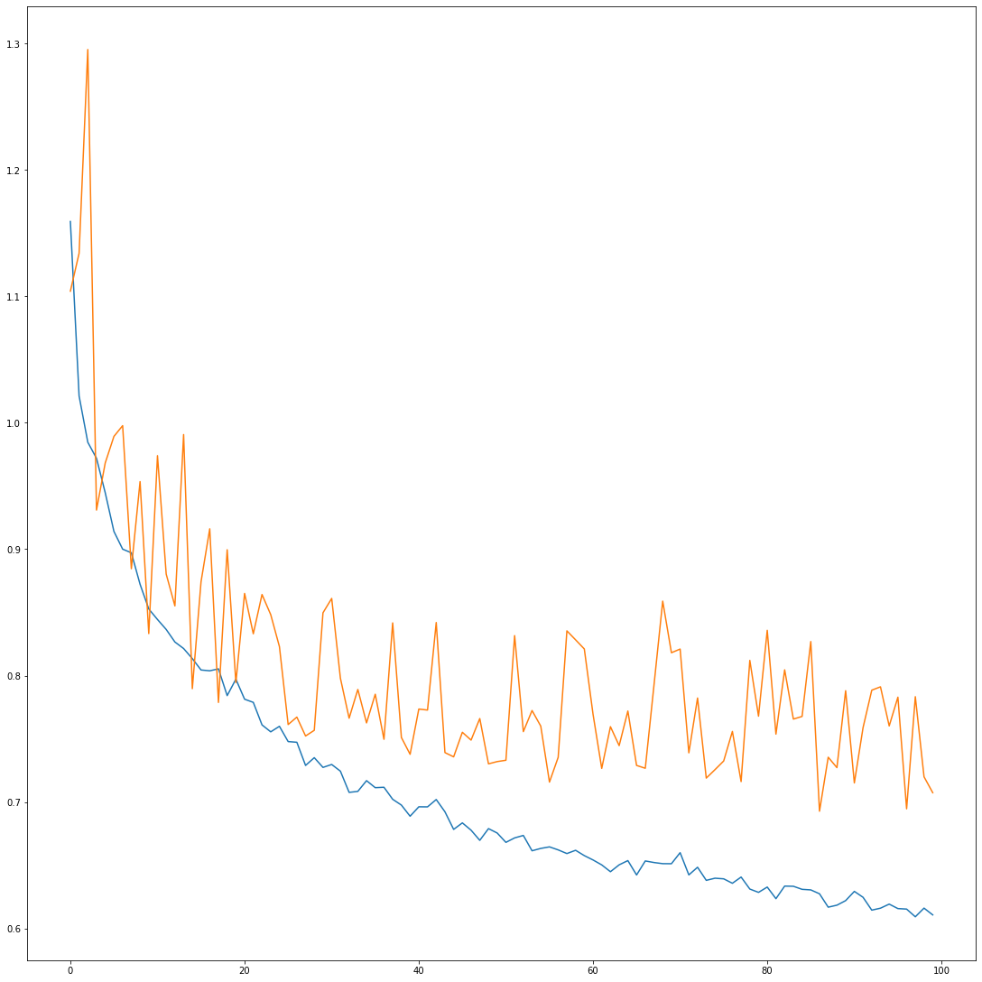
NNs:
Loss vs val_loss
Further refinement
Select RF with max_depth of 17
NN: hard to tune, computationally expensive.
Further tune model to firstly improve bias and then solve overfitting.
A
B
epoch

Slide 40
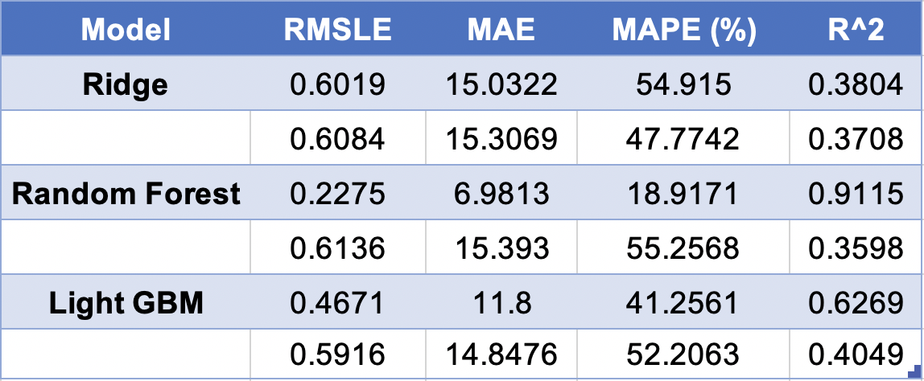
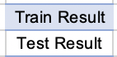
Small Sample Dataset, Using PCA 500 Features
40000 Train Samples, 10000 Test Samples

Slide 41
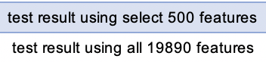
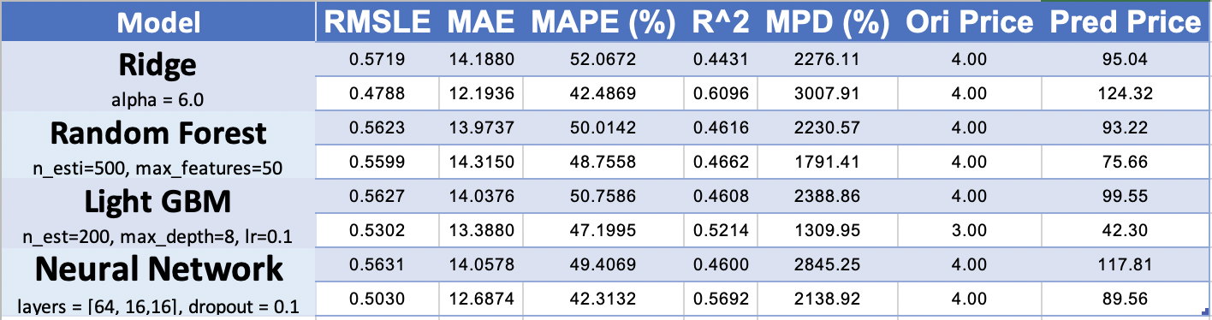
Small Sample Dataset Using Select 500 Best
40000 Train Samples, 10000 Test Samples
Train model with all Features better than train with select features

Slide 42
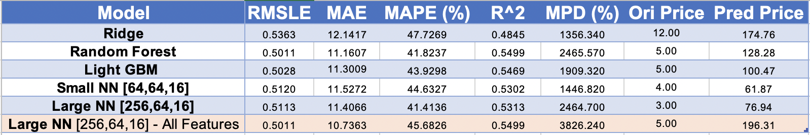
Large Sample Dataset (20% of original data)
Using select 2000 best features
207351 Train Samples, 88865 Test Samples
Ridge could dealing with smaller dataset but not large dataset
Train NN with all Features better than train with select features

Slide 43
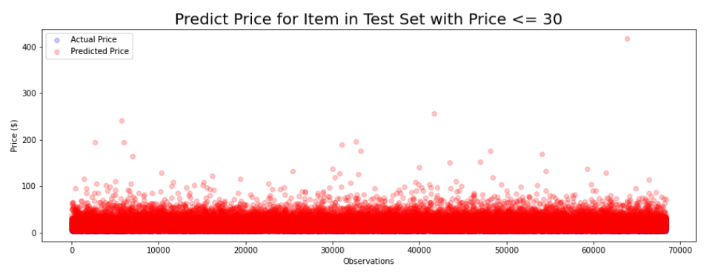
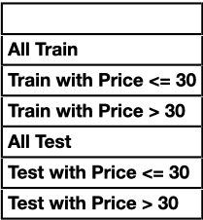
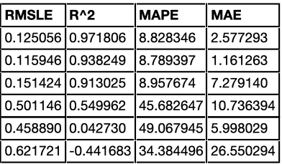
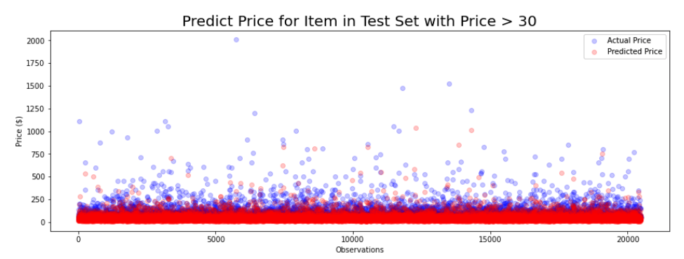
Large NN for all features

Slide 44
Findings and Conclusion
Findings
Using log to reduce the effect on the price outlier
SelectKBest is better than RFE in price prediction and more efficiency
Train model with all Features better than train with select features
Conclusion
Given an item description we can provide a suggested price range within error of $10 for similar items in the Mercari Marketplace
More training sample with more features will allow model to predict better price for the item
Notes:
RFE -> recursive feature elimination -> backward

Slide 45
Limitation
Limitation
Limited computer memory and process power, so cannot train for large data or more features
Few data information provide for the item and with many missing values
Will be interest if we have other data, such as the item rating and number of item views, see how it affect the price
Large time consuming for model training
Future Improvement
If we combine the category name and brand name into the item name, and then extract the feature, will that improve the result, as remove more unnecessary features?

Slide 46
Team Contribution
https://github.com/DSEI21000-S21/project-product-price-prediction

Slide 47
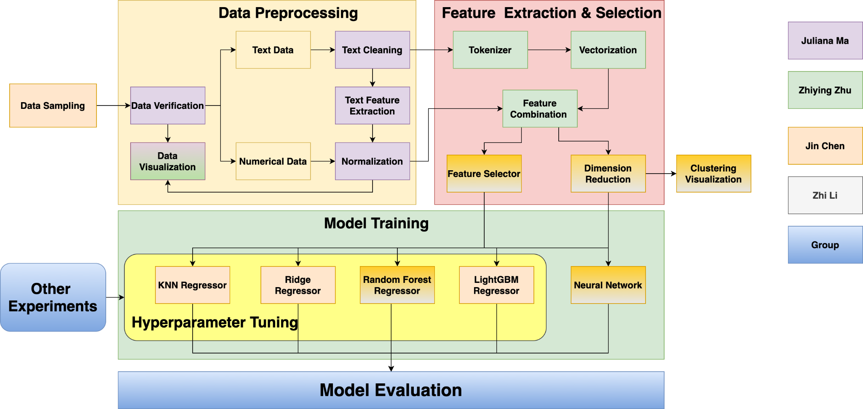

Slide 48
Appendix

Slide 49
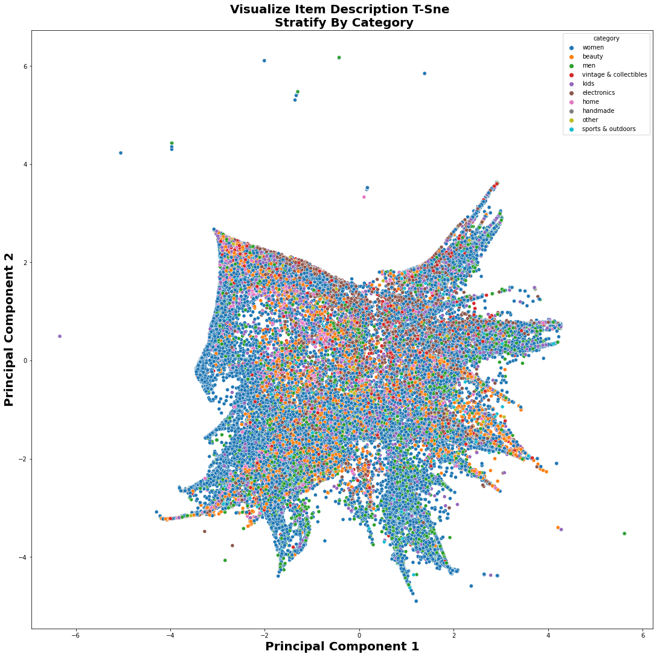
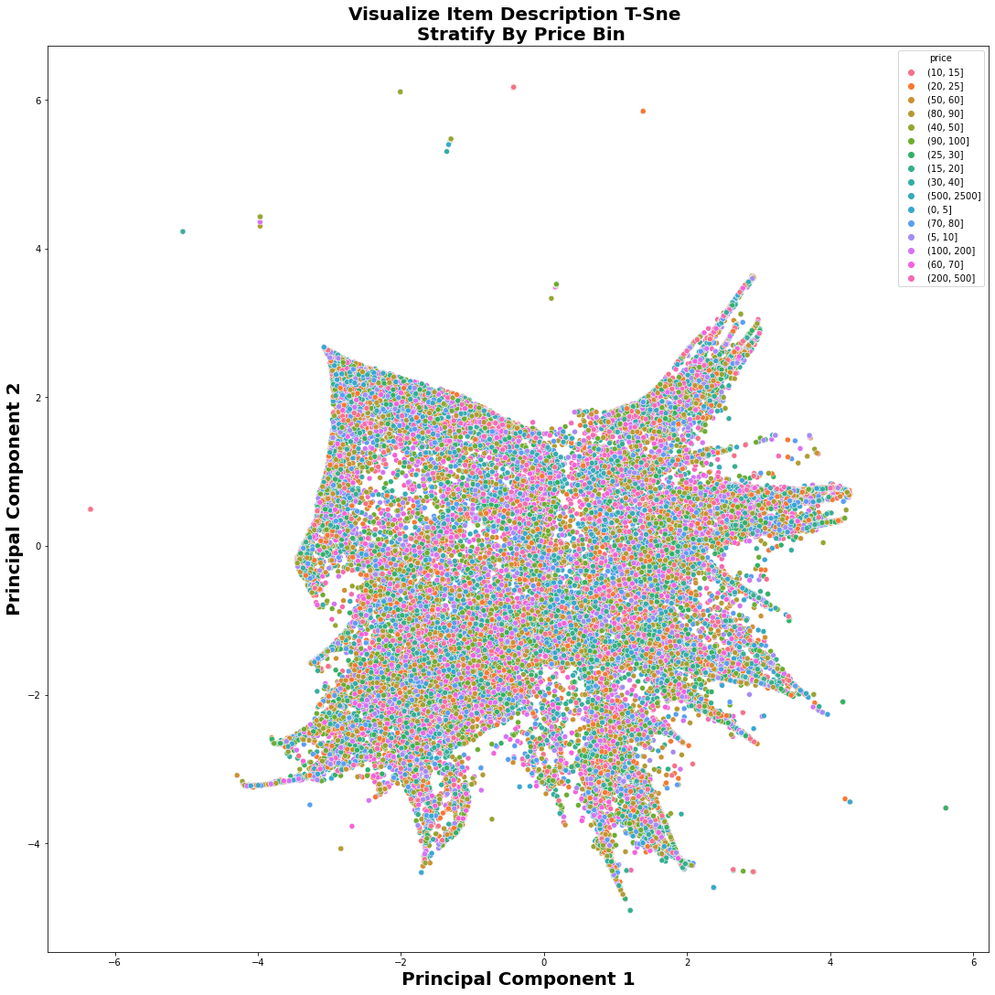
PCA + t-SNE
Notes:
After vectorization on the item description column, we converted 1 column to 10,000 columns because I limited maximum feature to be 10,000 when I used the tfidfvectorizer model from sklearn.
Now, the problem is we need to reduce the dimensionality from 10,000 to something more visualizable. Here I used pca to reduce the dimensionality from 10,000 to 10, and then use tSNE to visualize the 2 most important component vector.
I also tried linear Discriminant Analysis (LDA) and Isomap for dimension reduction. But they are taking so long to reduce the dimension. After waiting for 30-40 mins there is still no result output, so I gave up using LDA and Isomap for dimension reduction.
Jin also tried various dimension reduction techniques and did some visualizations.

Slide 50
